Slide 1
Classical Civilization
China

Slide 2



China
1200BCE-250BCE
Isolated
Balance of opposites
  For example: yin/yang…Daoism
  Emerged as a well integrated civilization in relation to government, philosophy, economics, and family relationships.

Slide 3
Dynasties
History is cyclical….one dynasty falls, another takes it’s place
  Shang
  Zhou
  Era of Warring States
  Qin
  Han

Slide 4
Zhou
1029-258BCE
Frequent attacks by nomads
Ruled with an alliance system
  A type of Feudalism
Mandate of Heaven began
Oracle Bones
A unifying language began: Mandarin
Fell and China entered into the Era of Warring States (403-221BCE)
  3 Schools of Thought
    Legalism, Confucianism, Daoism

Slide 5
Qin Dynasty
221-202BCE
Shi Huangdi (1st Emperor)
  Gave China it’s name
  What type of leader was he? Loved by the people? Feared? Effective?
  How did he “fix” China?
  Took power back from the nobles…made them all live with him..why?
  Hated Confucianism…460 scholars were burned alive, banned books

Slide 6
Qin Dynasty
Used his army to seize more land
Built the Great Wall of China
  3000 miles long
  Who actually built it?
Census for tax purposes; coinage; promoted silk manufacturing
Censored books/arts…why?

Slide 7
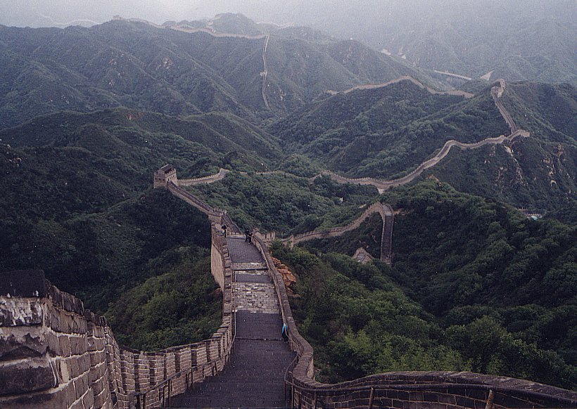
Great Wall of China

Slide 8
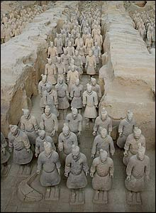
Shih Huangdi’s Tomb

Slide 9
Legalism
“Firm” approach
Agriculture and military are #1
Strict laws and order were necessary
Qin Shihaungdi was a BIG believer in legalism
  Known for CENTRALIZING China

Slide 10

Han Dynasty
206BCE-220CE
Maintained centralized government
Less brutal than Qin, begin their rule using Legalism, then backed off
Expanded territory/Military Might
Contact with Middle Eastern empires
Traded with Roman Empire, India, Central Asia
  Silk Road
Tribute System of Trade
  What was this?
Agriculture was the mainstay of their economy…flourished during this time due to long distance trade

Slide 11
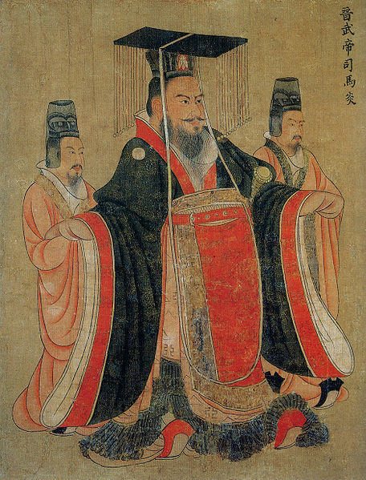
Han Continued
Wu Di (141-87 BCE)
  Ruler who built roads, canals, established a University based on Confucianism
    Civil Service Exam
    Expanded the foreign policy to include N. Vietnam and Korea
But between invasions (Huns) and loss of centralized control…the Han fell too and:
CHAOS …but the classical political, moral values survived.

Slide 12
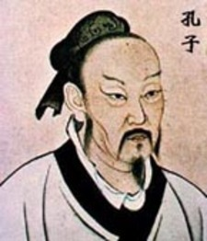
Confucius
551-479BCE
Created a central belief system for china based on obedience and respect
  Appropriate Feelings
  Correct Actions
Make education accessible to all
Filial piety was key…what is this?
5 Key relationships
  Ruler to subject
  Father to son
  Husband to wife
  Older brother to younger brother
  Friend to friend
Books called the Analects

Slide 13
Social Structure/Gender
Scholar-Gentry
  Highest class
  Took Civil Service Exam
Merchants?
  Had money but were lower class…why?
Patriarchal
  Upper class women could be educated in the arts, music, writing…
  Woman’s role is to marry well

Slide 14
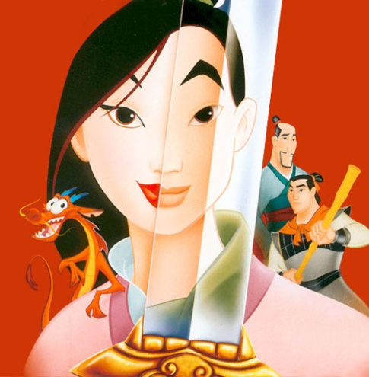
Culture
  Family is #1
  Pleasing ancestors is VERY important
Technology in the Han
  Wheelbarrow, watermills to assist with Agriculture
  Rudder to help with sea travel
  Paper-written word/records

Slide 15

Daoism (the way of nature)
Arrived in the 6th century…but there is some debate….perhaps earlier
Lao-zi-founder
Added the mysteries of nature to Confucius beliefs
Live frugally/don’t worry about politics or academics…
Leaders liked b/c it didn’t threaten their power

Slide 16
Order of Classical Chinese Society
1. Mandarins (landowning Aristocracy)
2. Peasants (laborers)/Artisans
3. “Mean” people (unskilled laborers)/slaves
4. what about Merchants?

